Slide 2
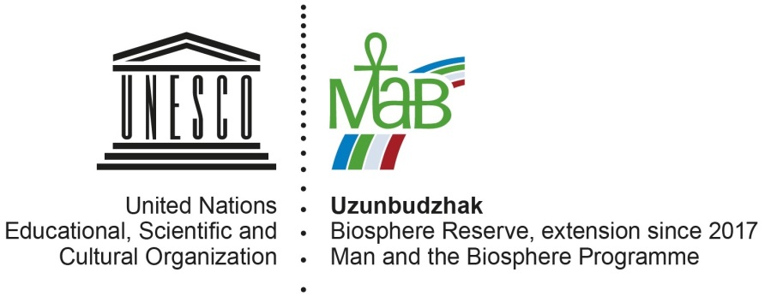
UZUNBUDZHAK BIOSPHERE REZERVE

Slide 3
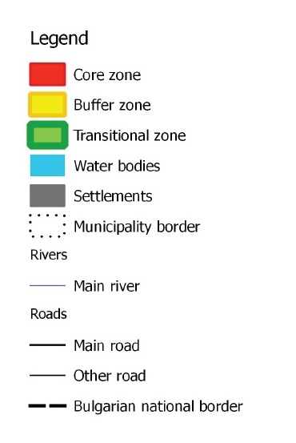
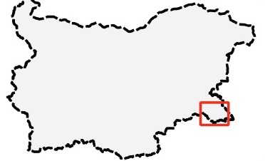
Characteristic
Total surface - 78424,53 ha
- core area - 4362.78 ha;
- buffer zone - 4626.49 ha;
- transition area - 69435.25 ha.

Slide 4
National legislation
Protected Areas Act:
3 reserves – Uzunbudzhak, Vitanovo, Sredoka;
12 protected areas – Strandjanska zelenika, Mechite dolove, Gradev sredok, Bosna, Veleka, Dokuzak, Krivinizovo, Moryane, Paroria, Bataka, Rudenovo, Petrova niva;
4 natural landmark – Kamenska burchina, Gradishteto, The Mladejka river springs and caves and Elenina dupka cave;
1 nature park – Strandja.
Biodiversity Act (Natura 2000):
Bird Directive BG0002040;
Habitats Directive BG0001007.

Slide 5
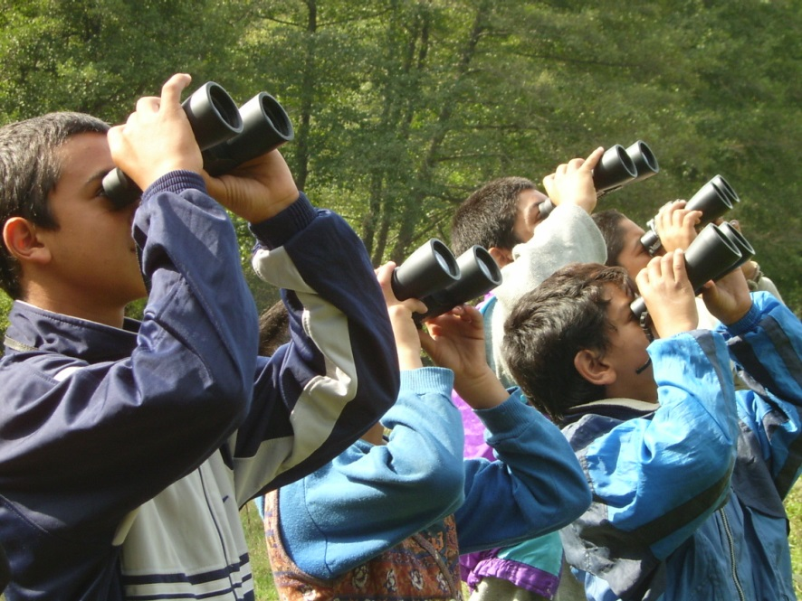
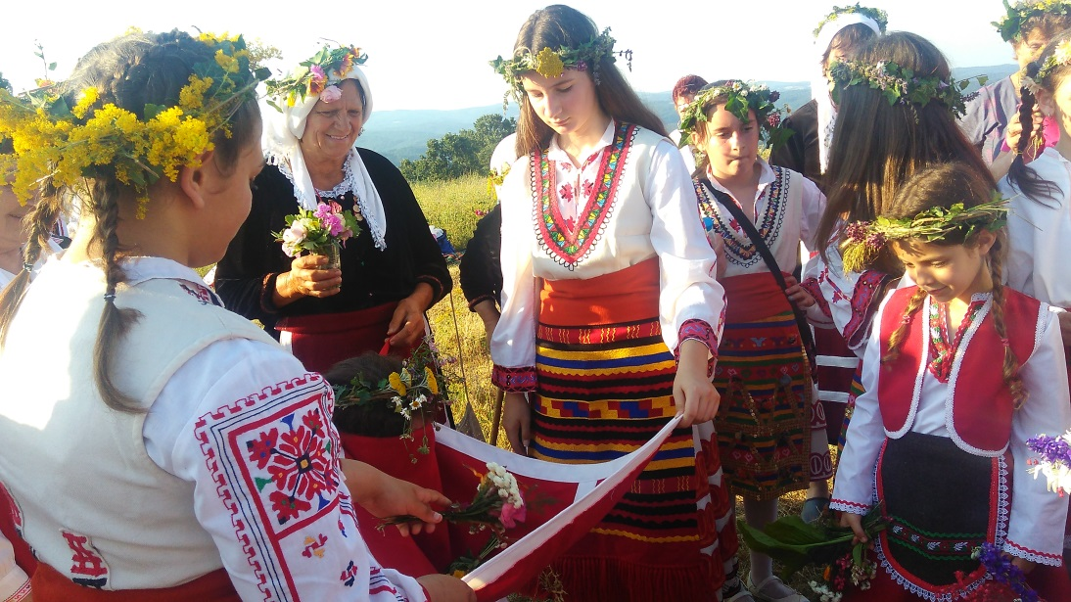
Main objectives
- Preservation of the biological diversity and the nature landscapes;
Research, conservation and development of cultural heritage;
Involving local communities in scientific research and monitoring;
Development of sustainable forestry;
Development of sustainable and eco-friendly tourism that involve local communities;
Development of a sustainable local industry and raising the quality of local products;
Good environmental education and etc.

Slide 6
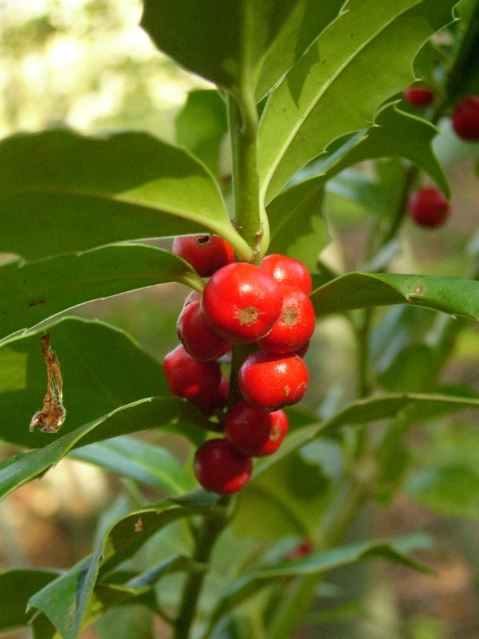
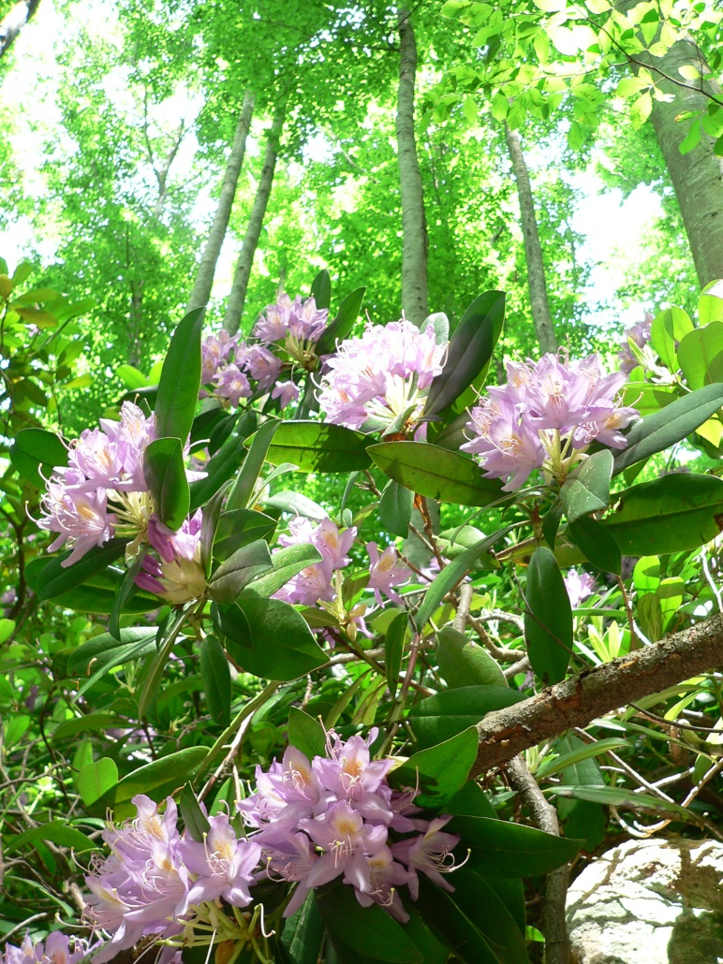
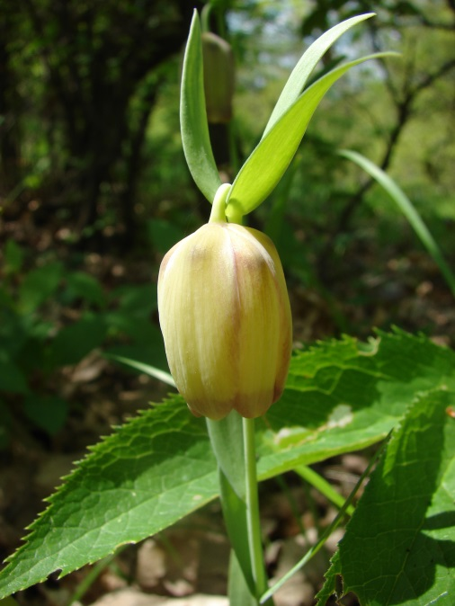
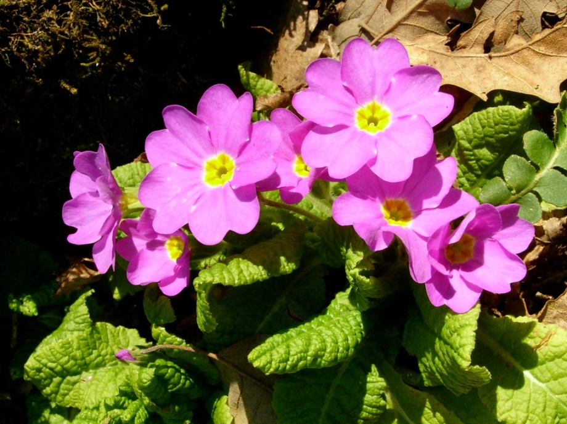
Flora
About 75 % of the territory of the BR is a forested area.
Habitat diversity:
According to the EUNIS classification system – 62;
According to the Habitats Directive – 21.
Vegetation stands out with big number of Tertiary relicts – 6.
Fritilaria pontica
Primula acaulis subsp. rubra
Ilex colchica
Fagus orientalis and Rhododendron ponticum

Slide 7
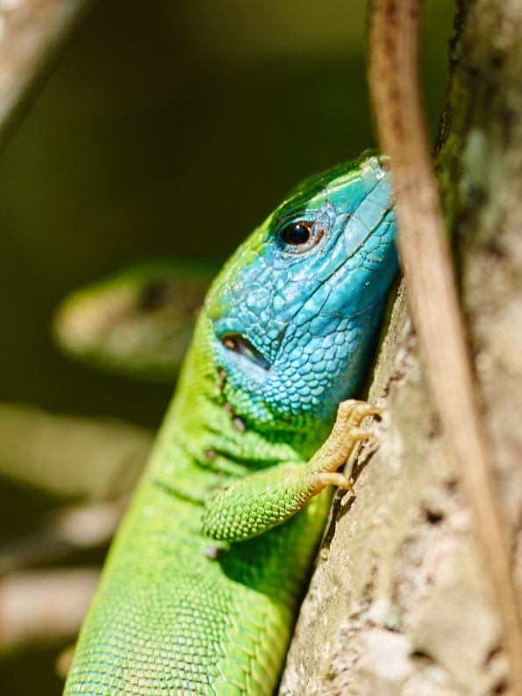
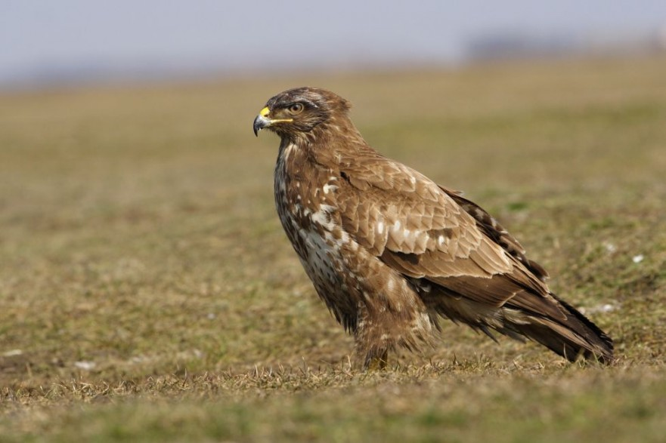
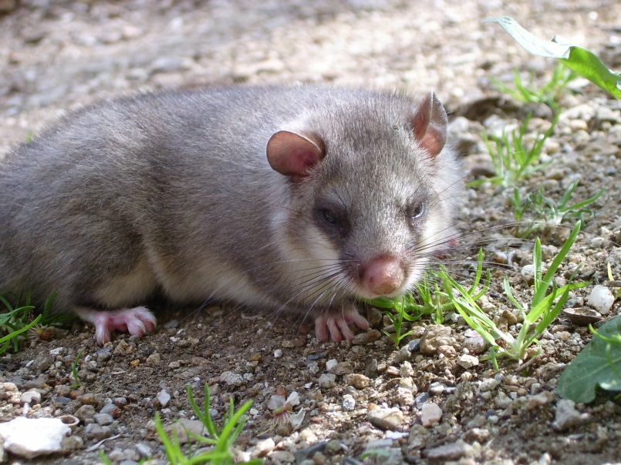
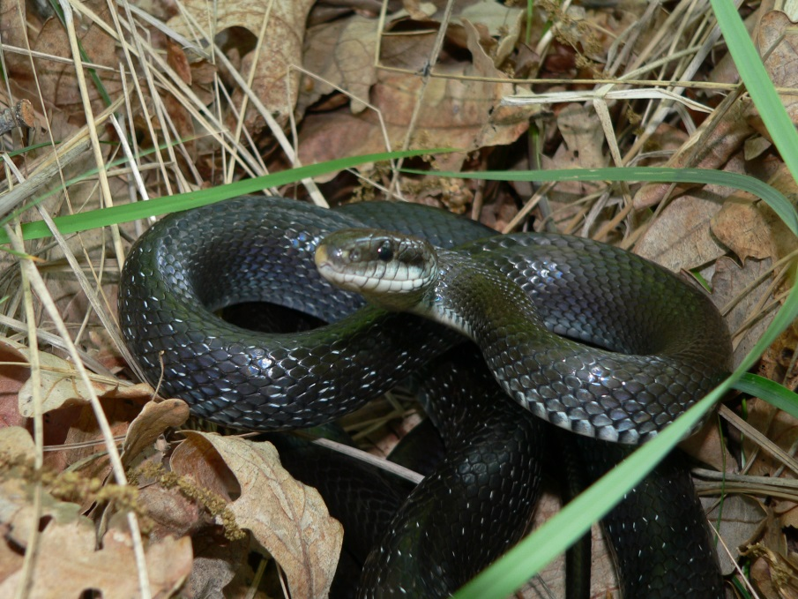
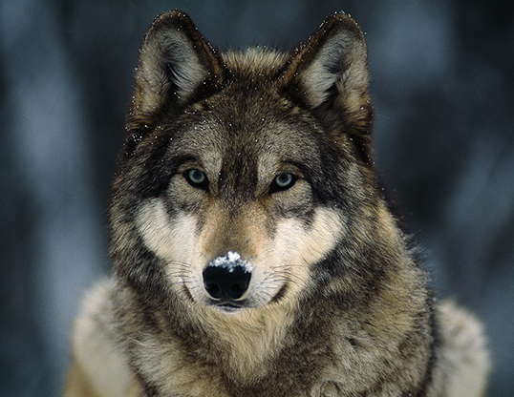
Fauna
150 rare and protected invertebrate species for Bulgaria and Europe;
71 mammals;
24 reptiles;
9 amphibians;
30 pisces;
269 birds.
Second major bird migration route for Europe – Via Pontica.
Buteo buteo
Glis glis
Canis lupus
Elaphe longissima

Slide 8
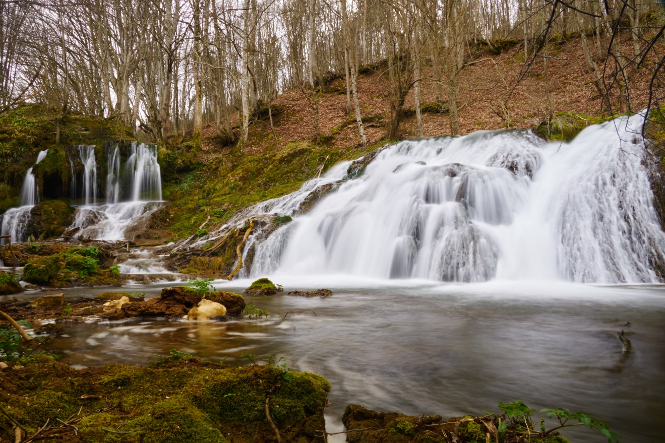
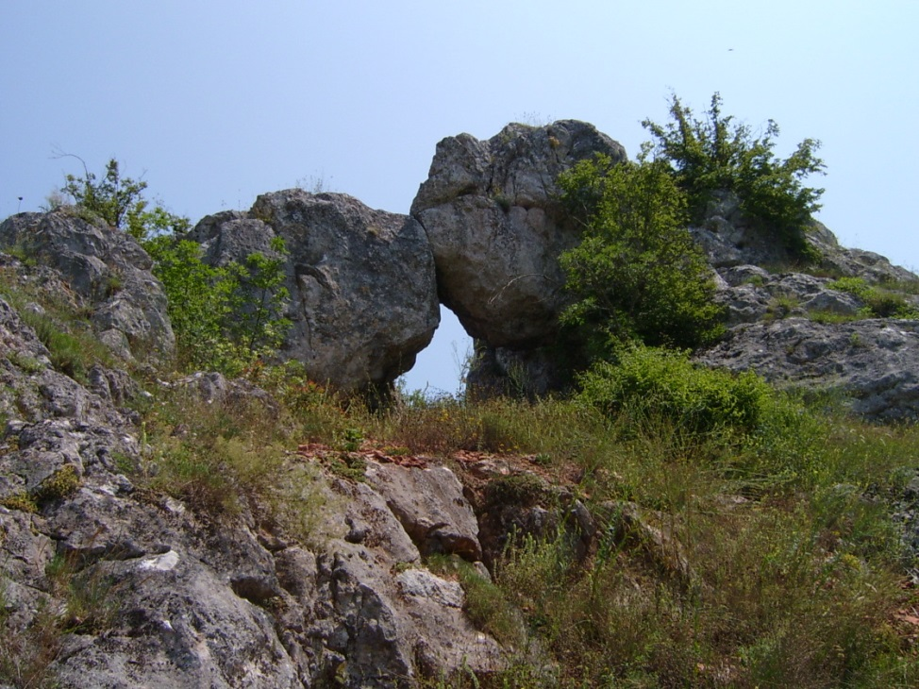
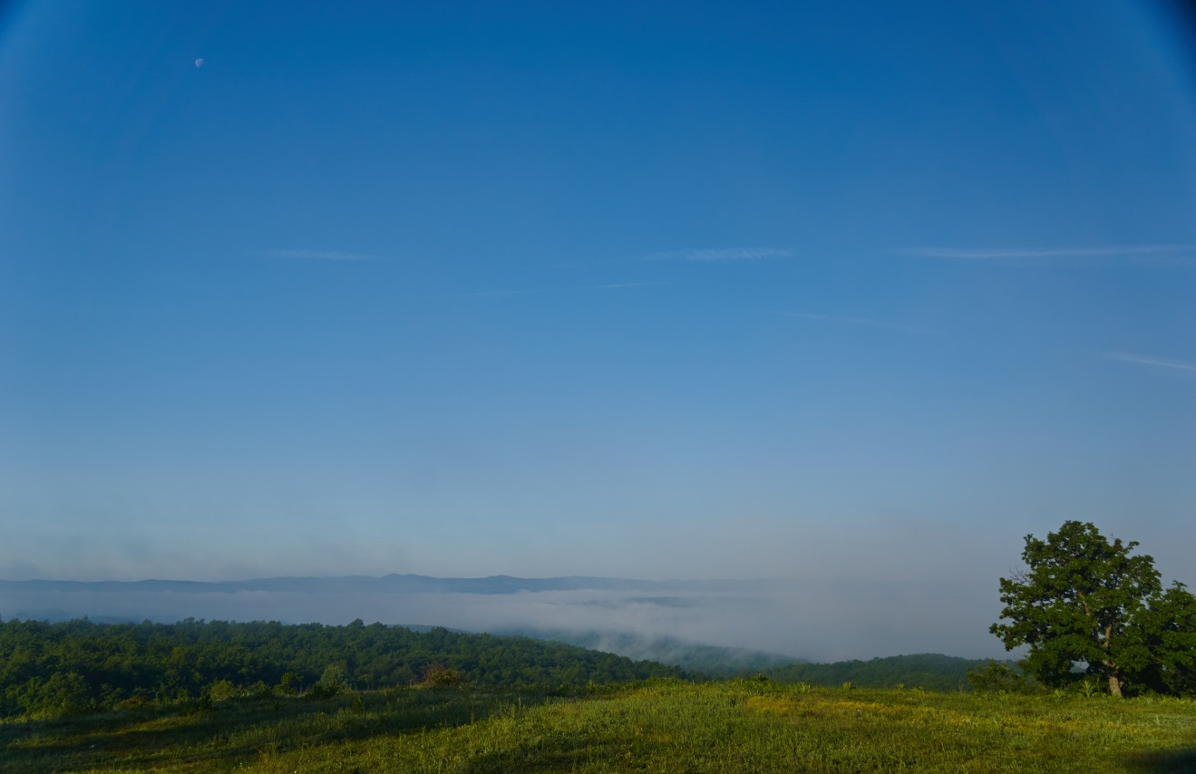
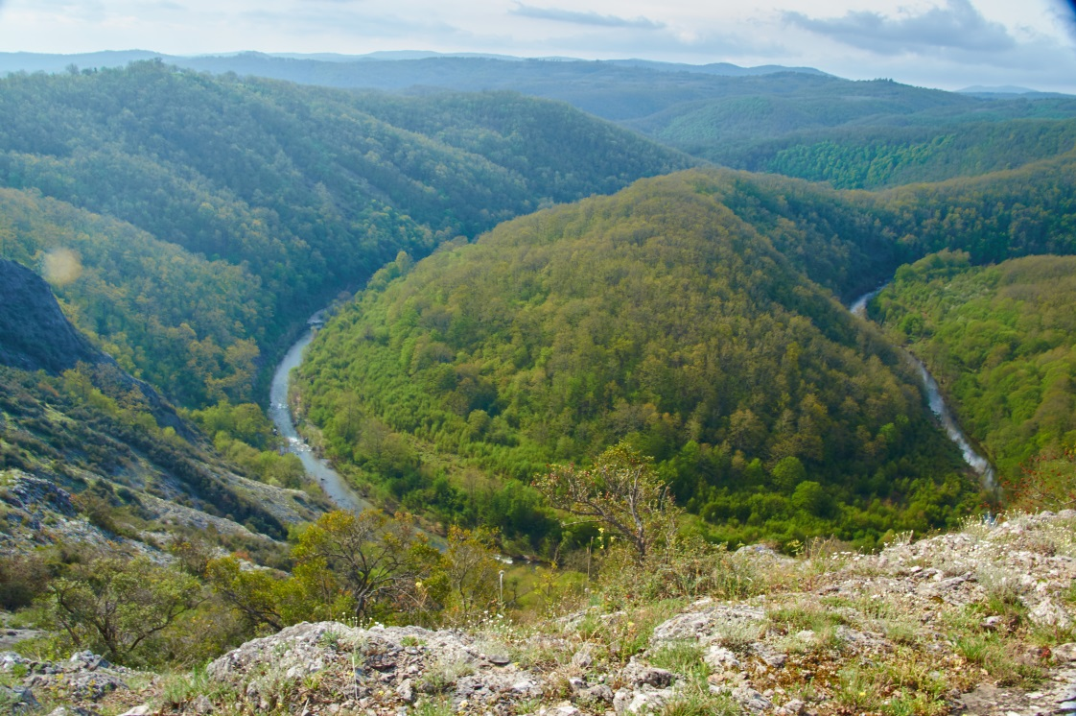
Landscape

Slide 9
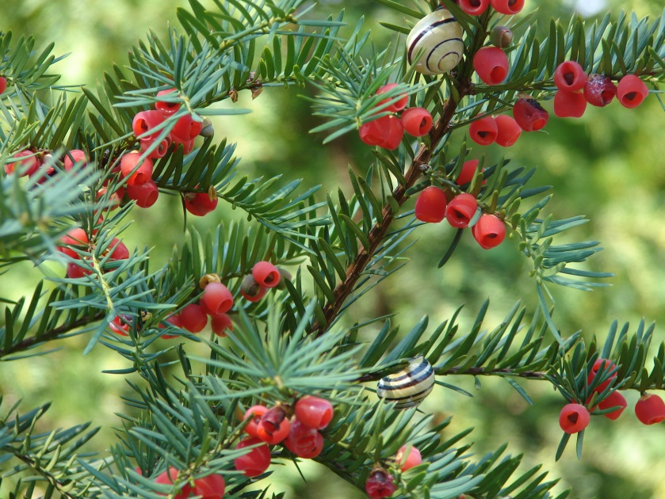
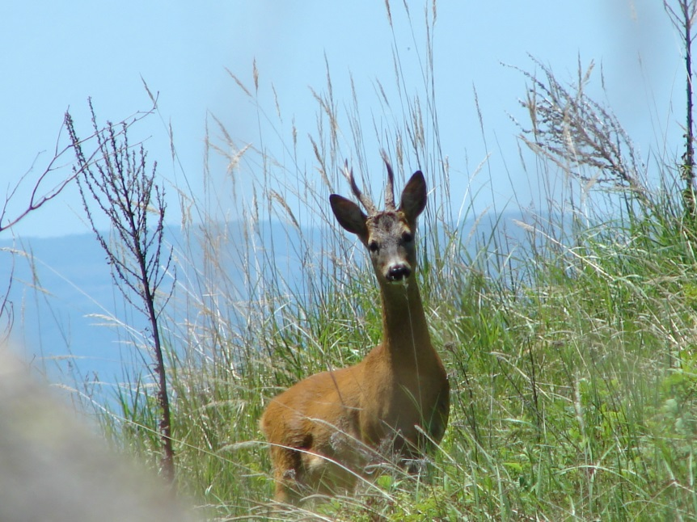
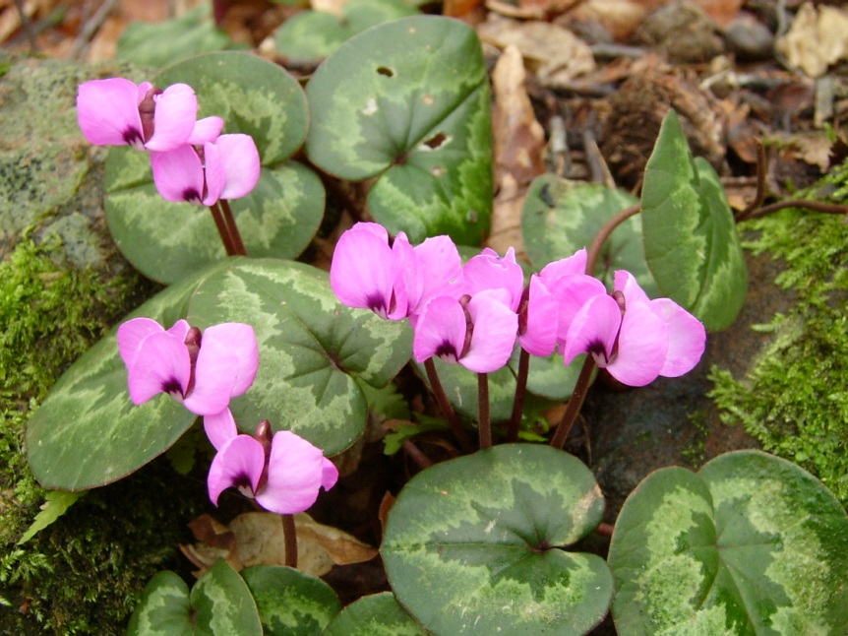
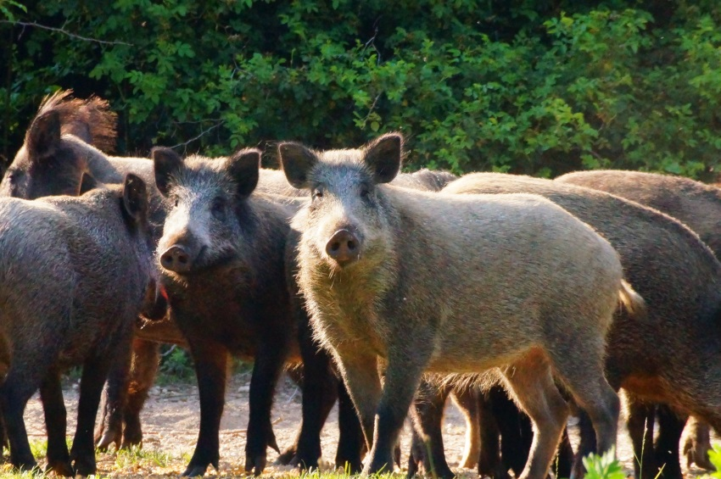
Ecosystems services
Timber industries
Gathering medicinal plants and herbs, forest fruits, mushrooms and snails
Game stock – birds and mammals;
Fishing.
Taxus baccata
Capreolus capreolus
Sus scrofa
Cyclamen coum

Slide 10
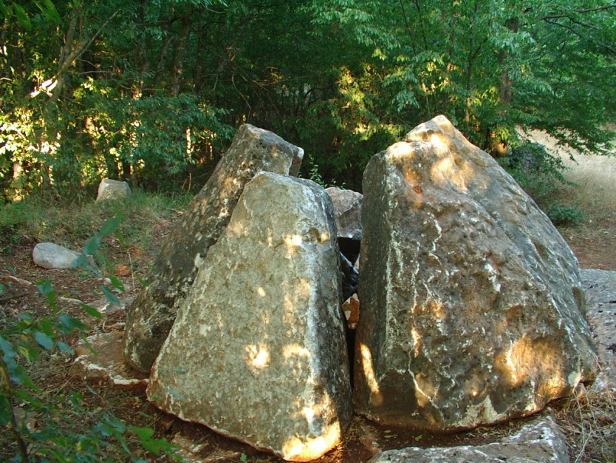
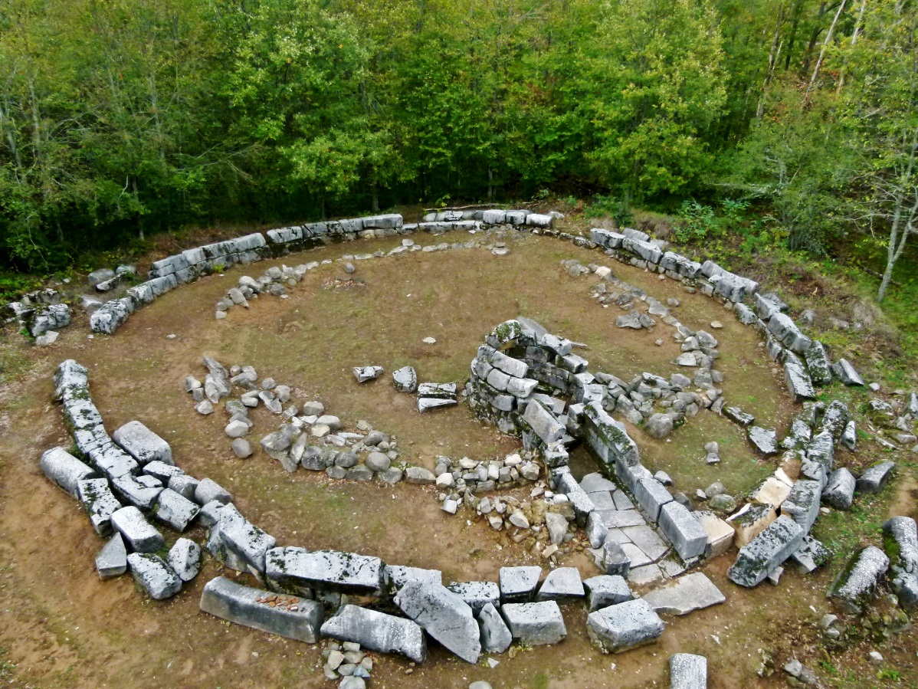
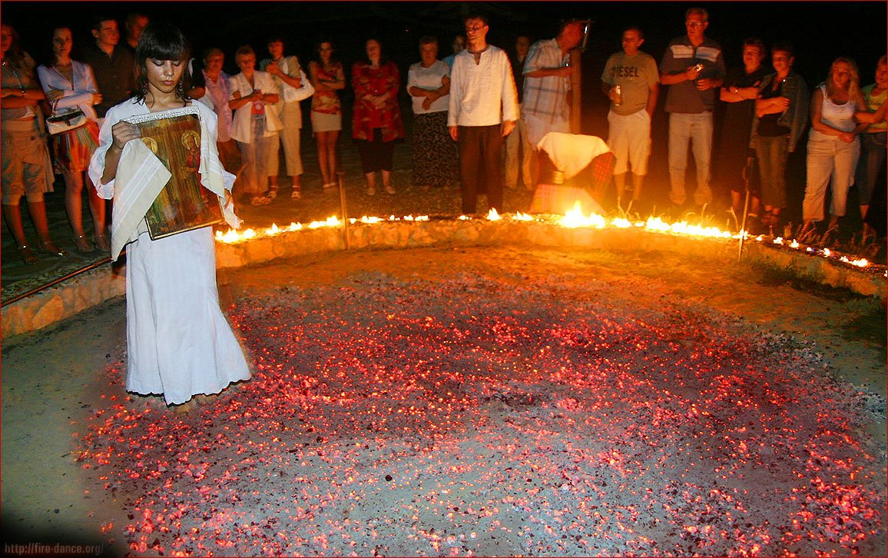
Cultural Heritage
The territory of the BR has a number of burial mounds with individual tombs and necropolis. The stone mounds dating back to the Thracians can be found all over Strandja. Scientific data show that there are layers from different ages to be found there. The stone mounds near Zabernovo and Evrenozovo still function as the so-called “cities of the dead” during the ancient Greek and Roman periods.

Slide 11
Thank you!

